Slide 1
Update on the Janssen®(JNJ) Ad26.COV2.S vaccine
Professors Glenda Gray & Linda-Gail Bekker

Slide 2

Sisonke provided the Janssen®(JNJ) Ad26.COV2.S vaccine to health workers ahead of the third wave
 | Sisonke vaccine
 | Pause of vaccinations
 | NDoH vaccine roll-out
Phase 1: health workers
Phase 2: Older adults & essential workers
Phase 3: Other adults
16 February
13 April
26 April
1 May
17 May
1 Sept

Slide 3
Sisonke phase 3B open label implementation study
Urgent intervention when national roll-out faltered because of Beta VOC
Able to offer HCW vaccine as part of this study as of the 17th February 2021
National Rollout 17th May 2021, so HCW got access months before general roll-out in time for 3rd wave
Provide effectiveness data on both Beta and Delta
Provide additional safety on the Ad26 SARS-CoV-2 data

Slide 4
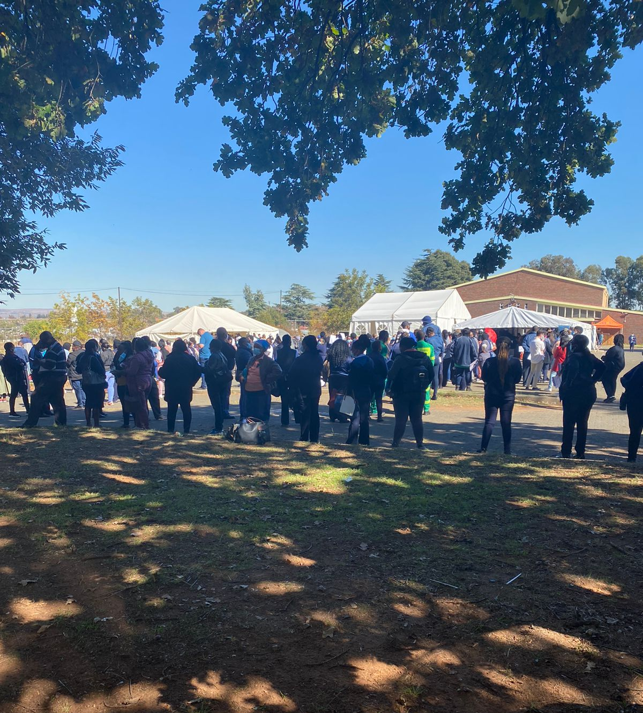
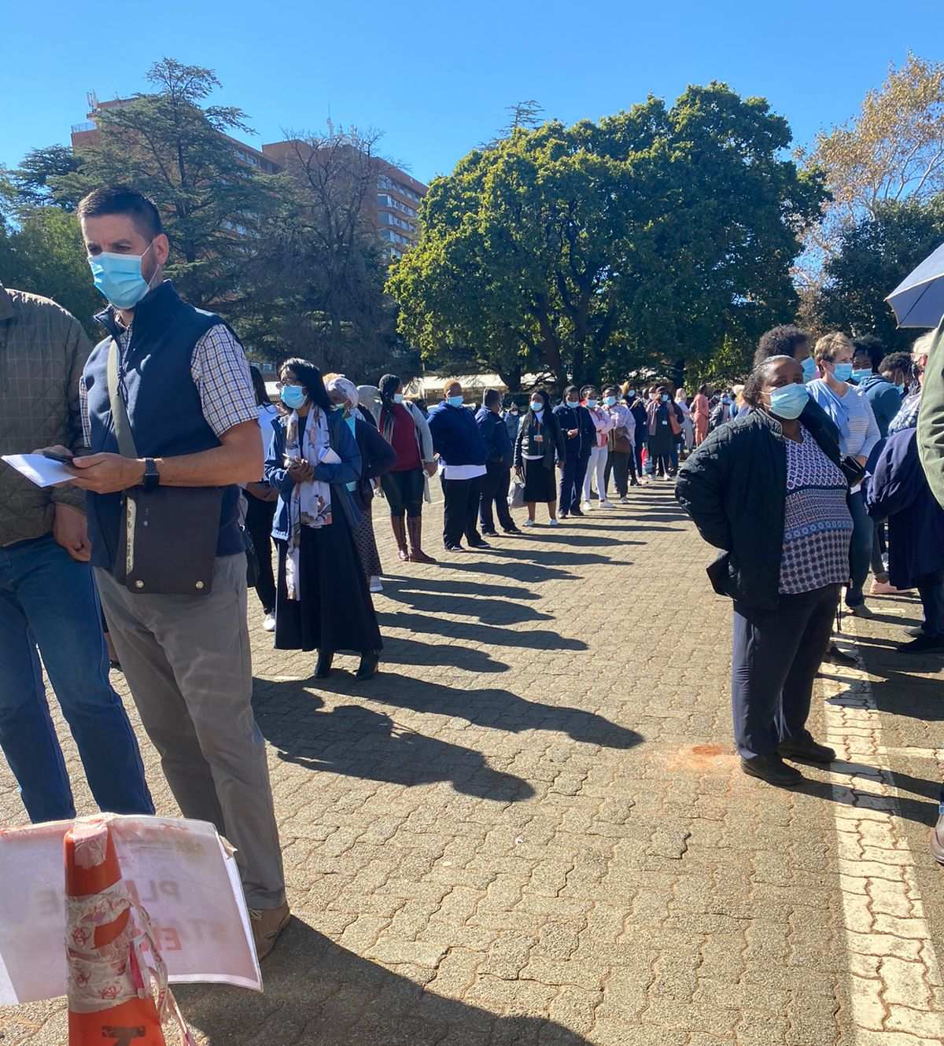
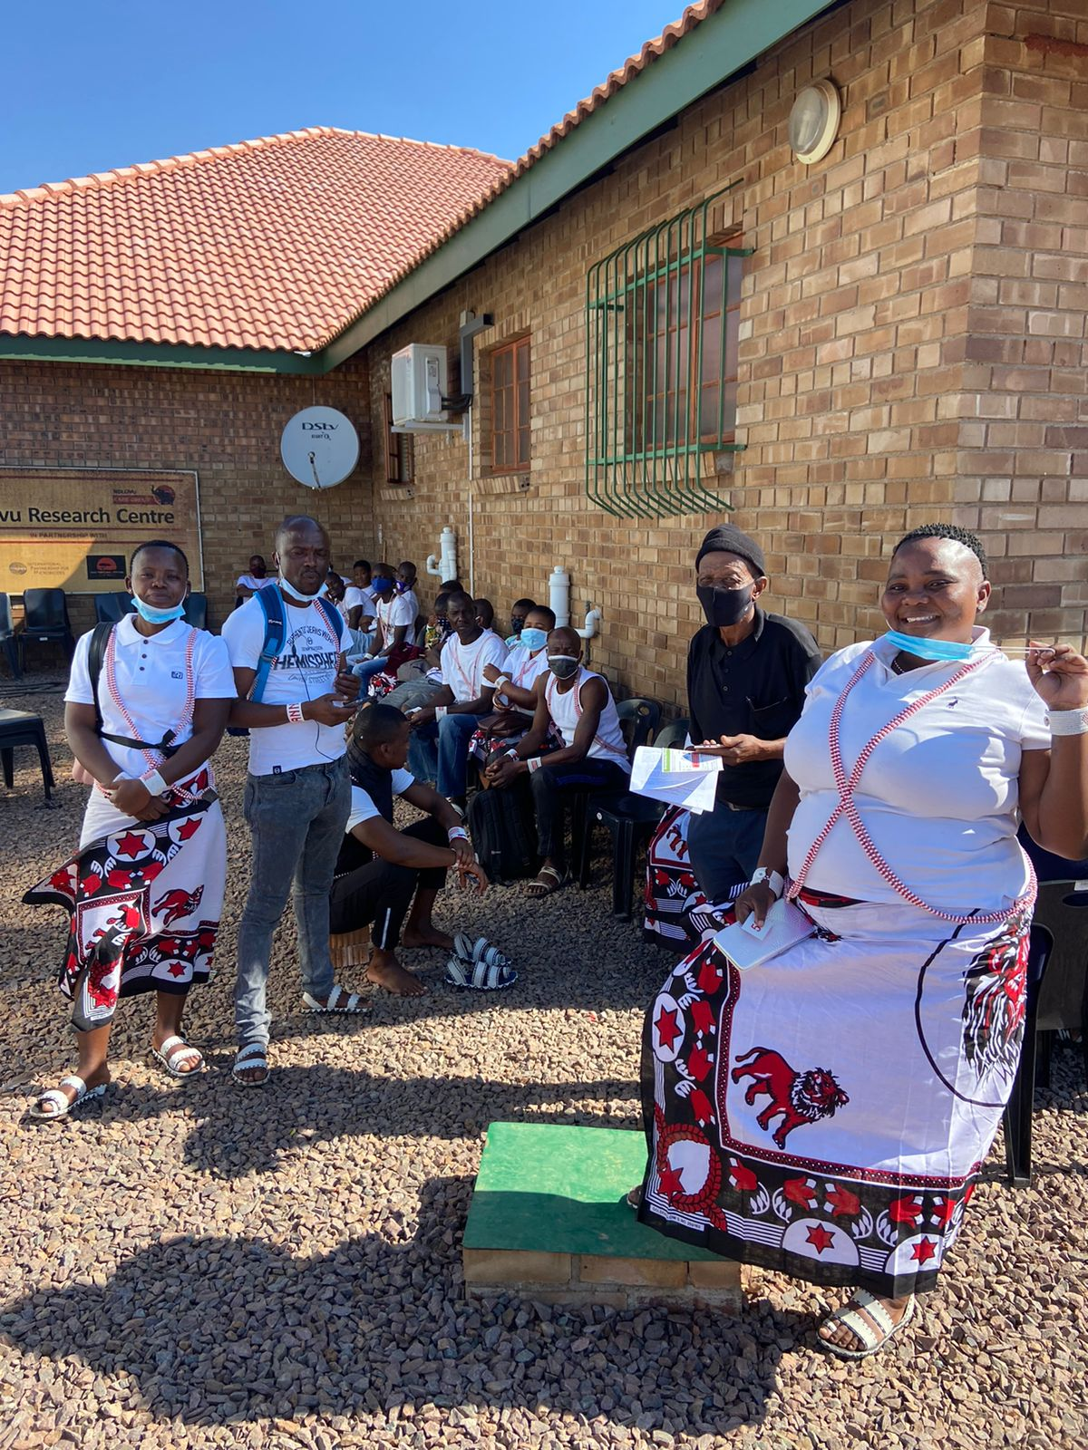
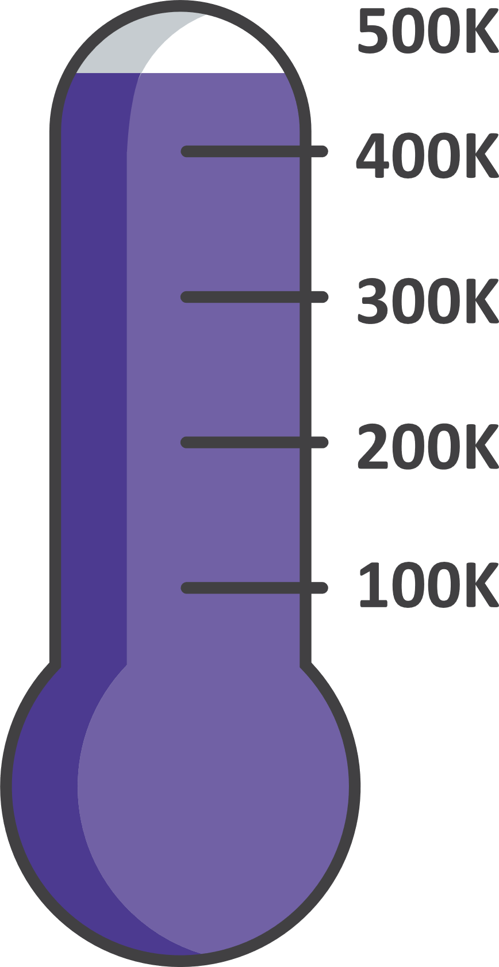
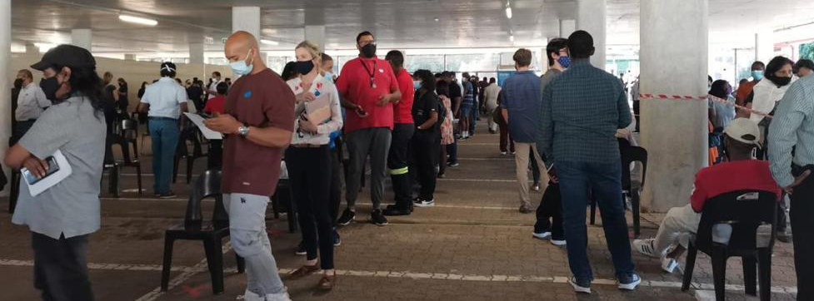
Sisonke Completed 17th May 2021
122
sites touched in total including rural extensions and mobiles
477 234
vaccinated health workers
Notes:
Please add photo of traditional health practitioners (sent via WhatsApp)

Slide 5
Criteria Considered for Analysis
Adjudication of infections: Mild/Mod/Severe
Used 3 data sets: 2 from medical insurers and one provincial persal data
Used 2-3 different analytical methods
For today we report on 2 data sets

Slide 6
Period of Analysis

Slide 7
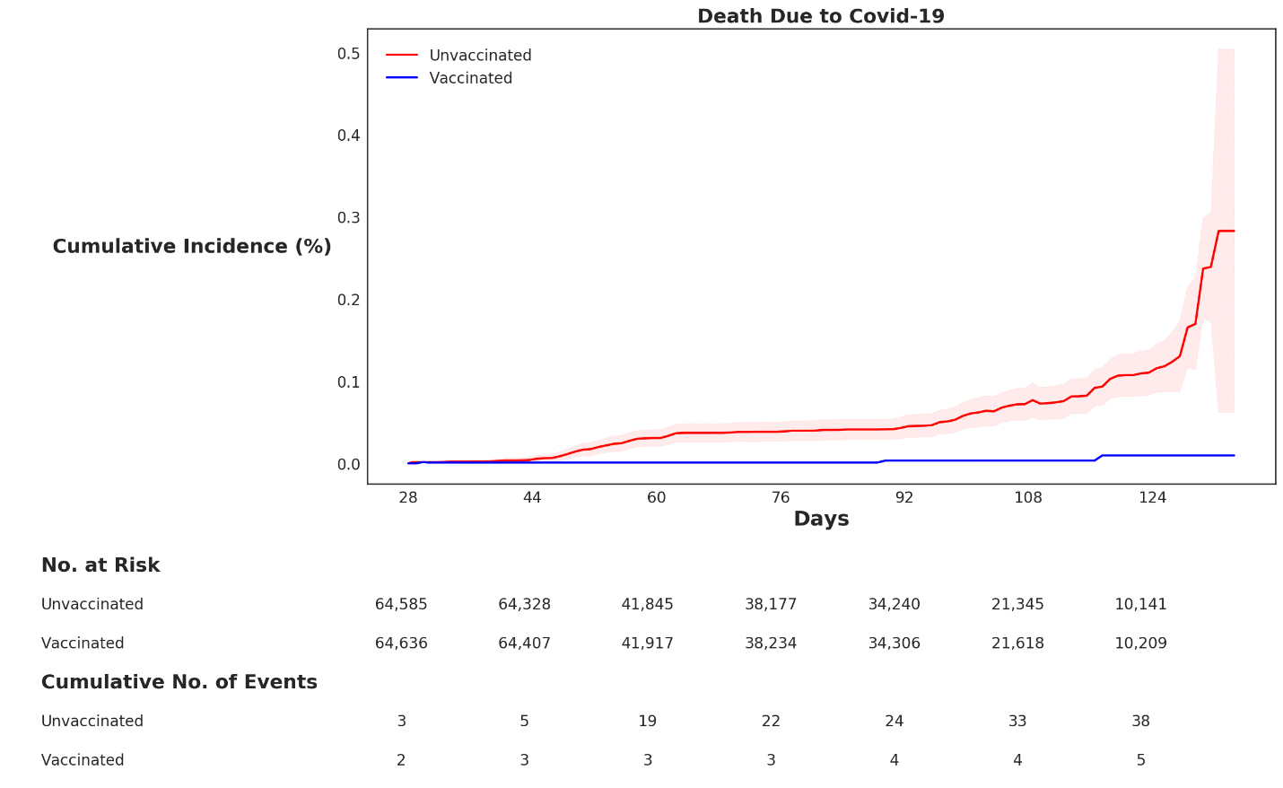

Vaccine Effectiveness: Death
91-96.2% protection against death

Slide 8
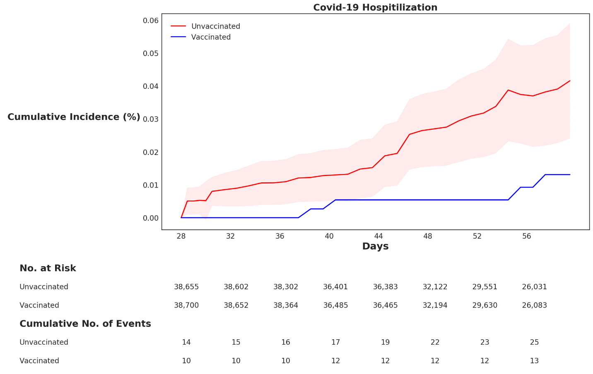
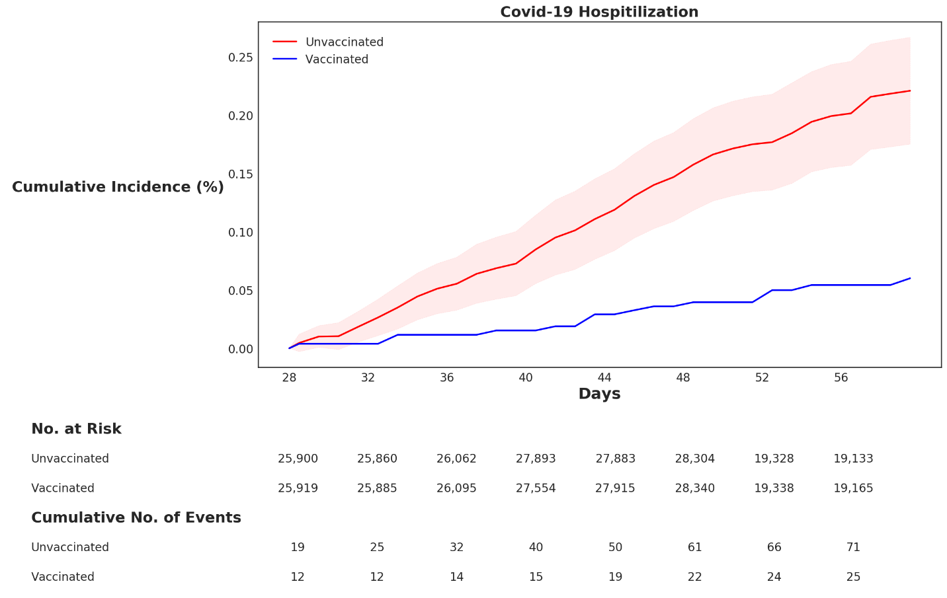
Beta versus Delta VE
Beta VOC
Delta VOC

Slide 9

The JNJ vaccine prevents hospitalisations and death
(results from two data sets)
1
100%
100%
91-95%
protection
65-66%
protection
0%
0%
Hospitalisation
Death

Slide 10
When breakthrough infections happen they are mild!
2

Slide 11
Protection is good against both beta and delta variants
3
100%
100%
71%
protection
67%
protection
0%
0%
Hospitalisation
(Beta dominant)
Hospitalisation
(Delta dominant)
N = 134 256 people
Protection is as good, if not better, against delta variant.

Slide 12
The JNJ vaccine is safe
4
No safety signal detected
In line with what we are seeing globally
Two cases of the rare clotting disorder (TTS – Thrombocytopenic Thrombosis Syndrome): Both have made a complete recovery.

Slide 13
Protection shows good durability
5
100%
100%
65%
Protection against hospitalisation
65%
Protection against hospitalisation
0%
0%
28-90 days post vaccination
90-120 days post vaccination
N = 134 256 people
There is no need for a booster yet.

Slide 14
Conclusion
We provide the world’s first evidence that the Ad26 COVID-19 (JNJ) is effective against the Delta VOC
Ad26 JNJ vaccine works well in South Africa and protects against severe disease and death
All the immune response data indicate good immediate and sustained immune response against Delta
Surprising durability in the immune response seen for single dose JNJ up to 8 months
Global real world effectiveness studies show similar VE as the phase 3 RCT

Slide 15
Acknowledgements
Johnson & Johnson
Paul Stoffels, Johan van Hoof, Abeda Williams and team
USG/NIH
Anthony Fauci, David Kessler, Robert Johnson, Larry Corey
RSA government
Treasury, NDOH, Natjoints Security Cluster
Biovac
Dr Morena Makhoana and team
Biocair
Leonard Lazarus and team

Slide 16
Acknowledgements
Funders:
Treasury/NDOH
Solidarity Fund
BMGF
Elma Foundation
Dell Foundation
US collaborators:
Larry Corey, Dan Barouch
Peter Gilbert, Holly Janes

Slide 17
Sisonke Study Team
Protocol Leadership
Glenda Gray
Linda-Gail Bekker
Ameena Goga
Nigel Garrett
Ian Sanne
Lara Fairall
Simba Takuva
Fatima Mayat
Jacquee Odhiambo
Sisonke Data team
Tarylee Reddy
Ishen Seocharan
Nonhlanhla Yende-Zuma
Safety Team
Azwidhwi Takalani
Imke Engelbrecht
Mark Faesen
NICD Epidemiology and Lab team
Cheryl Cohen
Harry Moultrie
Michelle Groome
Trevor Bell
Anne von Gottberg
Jinal Bhiman
SMC
Jeremy Nel, Chris Beyrer, Sipho Dlamini, Yunus Moosa, Francesca Conradie
PSRT
Barry Jacobson, Jonny Peters, Azwi Takalani, Vernon Louw, Jessica Opie, Pradeep Rowji
SAMRC
Michelle Mulder
Mongezi Mdhluli
National Department of Health
Milani Wolmarans
Petro Rousseau
Kevin Naicker
Western Cape Epi group
Andrew Boulle
Mary-Ann Davies
MRC Burden of Disease Unit
Debbie Bradshaw
Pamela Groenewald
KRISP – sequencing lab
Richard Lessells
Tulio D’Oliveira

Slide 18
Investigators and Clinical Research Sites
CRS | IoR
The Aurum Institute - Klerksdorp | Dr Craig Innes
The Aurum Institute -Tembisa Clinic 4 | Dr Kathy Mngadi
The Aurum Institute - Rustenburg | Dr William Brumskine
The Aurum Institute - Pretoria | Dr Coert Grobbelaar
Vulindlela | Dr Disebo Makhaza
eThekwini | Dr Nivashnee Naicker
Khayelitsha | Dr Amy Ward and Prof Graeme Meintjes
CRISMO Bertha Gxowa Research Centre | Dr Musawenkozi Mamba
Emavundleni CRS | Dr Scott Hayden Mahoney
Masiphumelele CRS | Dr Katherine Gill
Josha Research CRS | Dr Johan Lombaard
MeCRU CRS | Prof Maphoshane Nchabeleng
Botha’s Hill CRS | Dr Elizabeth Spooner
Chatsworth CRS | Dr Logashvari Naidoo
Tongaat CRS | Dr Vimla Naicker
Mzansi Ethical Research Centre (MERC) | Dr Friedrich Petrick
Ndlovu Research Centre (Elandsdoorn CRS) | Dr Rebone Maboa
CRS | IoR
PHOENIX Pharma (Pty) Ltd | Dr Niel Malan
Kliptown Soweto CRS | Dr Erica Lazarus and Anusha Nana
Soweto - Bara HVTN CRS | Dr Erica Lazarus and Anusha Nana
Qhakaza Mbokodo Research Clinic CRS | Dr Philip Kotze
SATVI, Brewelskloof Hospital | Angelique Luabeya
Setshaba Research Centre CRS | Dr Khatitja Ahmed
Synexus Stanza (Mamelodi) CRC | Dr Sheena Kotze
Synexus Helderberg Clinical Research Centre | Dr Dorothea Urbach
Synexus SA - Watermeyer CRC | Dr Elane van Nieuwenhuizen
TASK Central | Prof Andreas Diacon
Tread Research | Prof Lesley Burgess
Themba Lethu HIV Research Unit (CHRU) | Dr S Badal-Faesen and Phuti Mohlala
Groote Schuur HIV CRS | Dr Sheetal Kassim
FAM-CRU (Family Clinical Research Unit) | Dr Shaun Barnabas
Nelson Mandela Academic Research Unit CRS | Prof Thozama Dubula
Wits RHI Shandukani Research Centre | Dr Faeezah Patel

Slide 19
Acknowledgements
Andrew Boulle
Reshma Kassanjee
Mary-Ann Davies
Hassan Mahomed
Western Cape Department of Health
Western Cape Provincial Health Data Centre

Slide 20
Acknowledgements: Discovery Team
Shirley Collie
Jared Champion
Tommy Chen
Donald Ntjana
Matt Zylstra
Discovery Health
The Discovery Health Business Intelligence and Big Data Administration teams

Slide 21
http://sisonkestudy.samrc.ac.za
Thank you to our staff, partners, funders and government.

