Slide 1

Role of community pharmacies in the vaccination rollout
Jackie Maimin

Slide 2
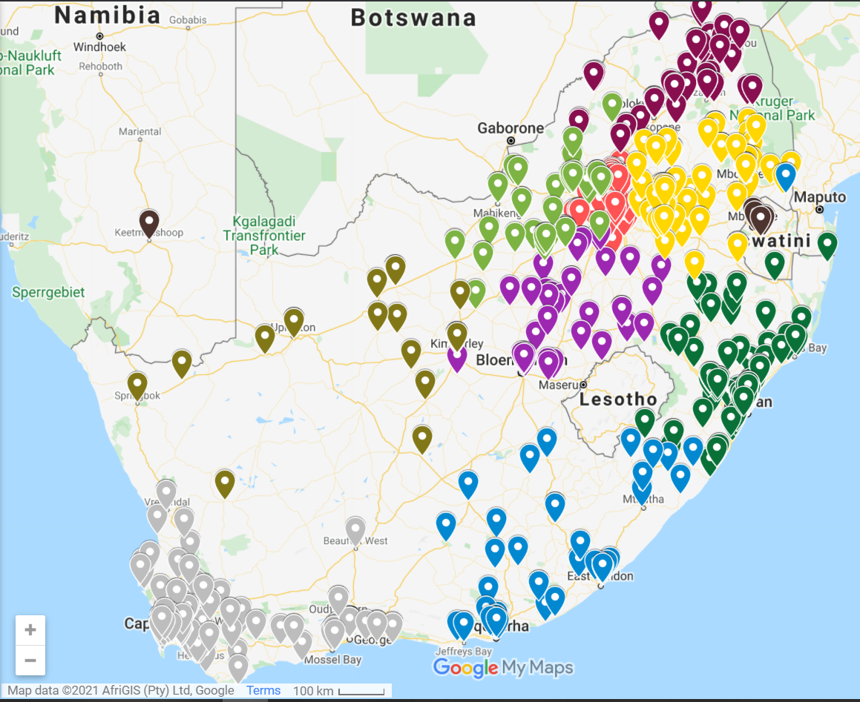

1230
Independent Community Pharmacies across South Africa

Slide 3
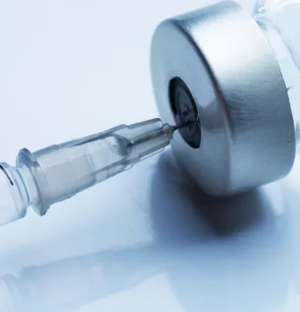
Vaccinations through pharmacy
With the arrival of the first vaccines in South Africa, pharmacists as the custodians of medicine and experts in cold chain management, were central to the vaccine supply chain.
Pharmacies serving their local community joined the vaccination rollout programme in the largest public private partnership ever seen in SA.
With their primary health clinics, pharmacists and nursing sisters are ideally positioned to offer COVID-19 vaccinations in a health setting.

Slide 4
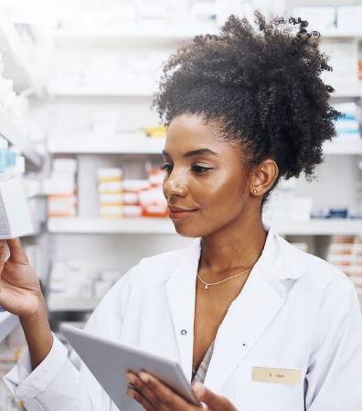
Ask Your Pharmacist
Pharmacists are accessible health care professionals
Available long retails hours, after-hours and over weekends
Offer advice over any vaccine concerns, co-morbidity questions or worries over potential drug interactions
Pharmacies have remained open even through hard lockdown and put effective infection control measures in place to keep people safe

Slide 5

Vaccination Site Preparedness
The process to become a vaccination site is a complex process with numerous stops and checks;
Curation by the South African Pharmacy Council
Permit issued by National Department of Health
COVID-19 Vaccine training for vaccinators
Site readiness checks and registration of site on EVDS and SVS
Ordering of consumables eg syringes, needles, diluent
Safe disposal of used sharps, vials, medical waste
Implementation of strict infection control protocols
Ordering and cold chain management of vaccines
Intended to ensure a safe vaccination environment for you the public

Slide 6
Processing vaccinations
Vaccinators and administrators checked and then registered on EVDS
Stock is received, cold chain checked and stock put directly into freezers or fridges and uploaded into the SVS to monitor usage & stock levels
Fridges have 24 hour monitoring devices and temperatures are checked and recorded twice daily
Once defrosted vaccines cannot be refrozen and they must be used within the efficacious time frame
Day of vaccination, vials are brought to room temperature, any reconstitution is done and vials are monitored and used within new time frames
Every step is monitored and recorded to ensure vaccines are not compromised and are effective at time of vaccination

Slide 7
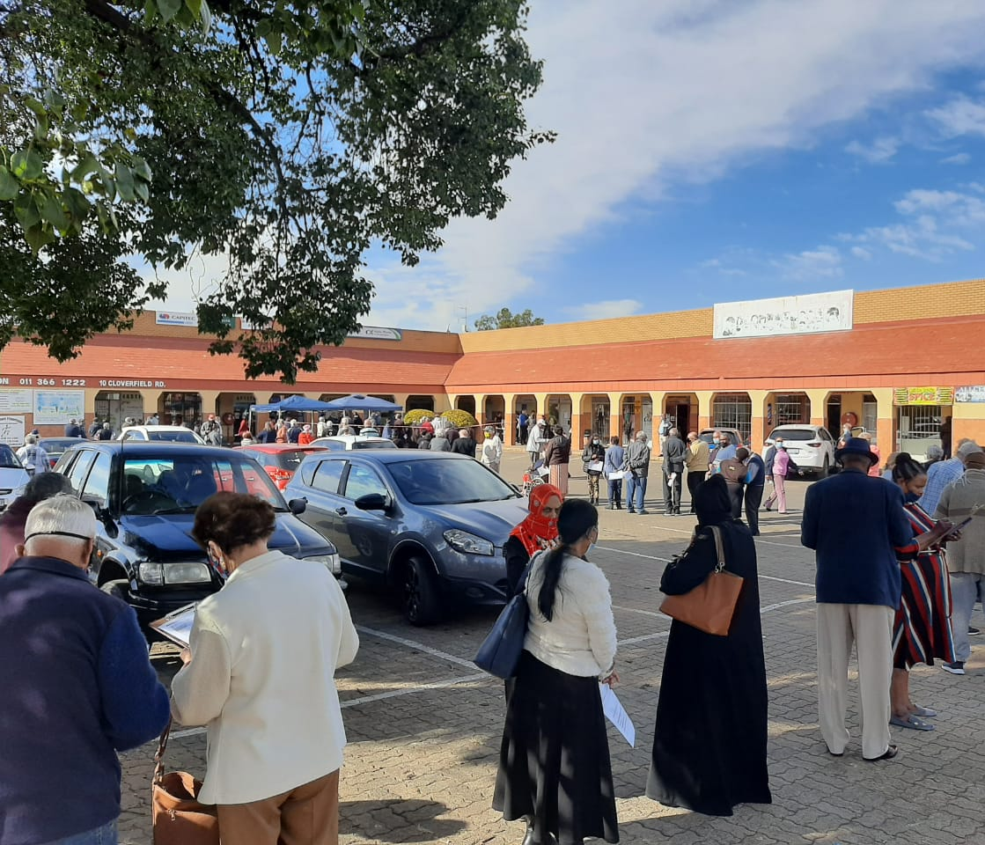
Taking Vaccines to the People
Outreach services from pharmacies are being offered to cover;
Retirement villages
Old age homes
Mines
Factories
Work places and businesses

Slide 8
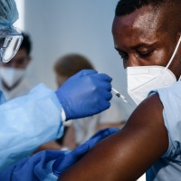
Equitable Access
Pharmacy vaccinations sites accept eligible people;
Who have scheduled vaccination appointments from EVDS
appointments booked by phone, email or whatsapp
walk-ins (vaccine and slots permitting)
both insured and uninsured
with SA ID documents or passports
at no cost to the person

Slide 9
Vaccination Site Onboarding
Total Number of sites currently vaccinating : 324
Average vaccinations per site per day: 99
Total sites with permits & ready to vaccinate: 588
Sites in pipeline: 264
Percentage of sites ready or vaccinating: 55%
Current site capacity >30 000 per day
Full site capacity if all sites online about 50 000 vaccinations daily
1000 000 vaccinations per month

Slide 10
Vaccination Site Activation
17 May – first 2 sites in Gauteng – Ackermans and East Park Pharmacies, our pioneers, who now jointly provide 1200 vaccinations/day
24 May – 25 sites mostly rural – Laphalele, Thabazimbi, etc
More Pfizer sites were added each week
The arrival of J&J vaccines this week has added many more vaccination sites especially in the underserviced and rural areas such as Giyani, Thaba Nchu, Mamelodi and Khayelitsha

Slide 11
South African Pharmacy Council
Register of Pharmacies
Sector | EC | FS | GP | KZN | LP | MP | NW | NC | WC | Total
Academic Institution | 2 | 0 | 3 | 1 | 1 | 0 | 1 | 0 | 1 | 9
Community Pharmacy | 317 | 164 | 1250 | 592 | 238 | 295 | 175 | 71 | 497 | 3599
Consultant Pharmacy | 0 | 0 | 5 | 0 | 0 | 0 | 0 | 0 | 1 | 6
Institutional Private | 23 | 17 | 114 | 61 | 10 | 14 | 18 | 6 | 48 | 311
Institutional Public | 104 | 50 | 73 | 101 | 38 | 45 | 40 | 28 | 133 | 612
Manufacturing Pharmacy | 13 | 1 | 187 | 9 | 1 | 2 | 5 | 0 | 33 | 251
Wholesale Pharmacy Private | 17 | 5 | 90 | 21 | 3 | 3 | 1 | 3 | 30 | 173
Wholesale Pharmacy Public | 2 | 1 | 1 | 1 | 1 | 1 | 1 | 1 | 1 | 10

Slide 12
Pharmacies and Doctors
3599 pharmacies includes corporate pharmacies also providing vaccinations
General practitioners waiting to come online many working together with pharmacy
Hospitals
Occupational health sites
Working towards 1000 000 shots every 3 days by the private sector

Slide 13
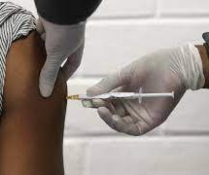
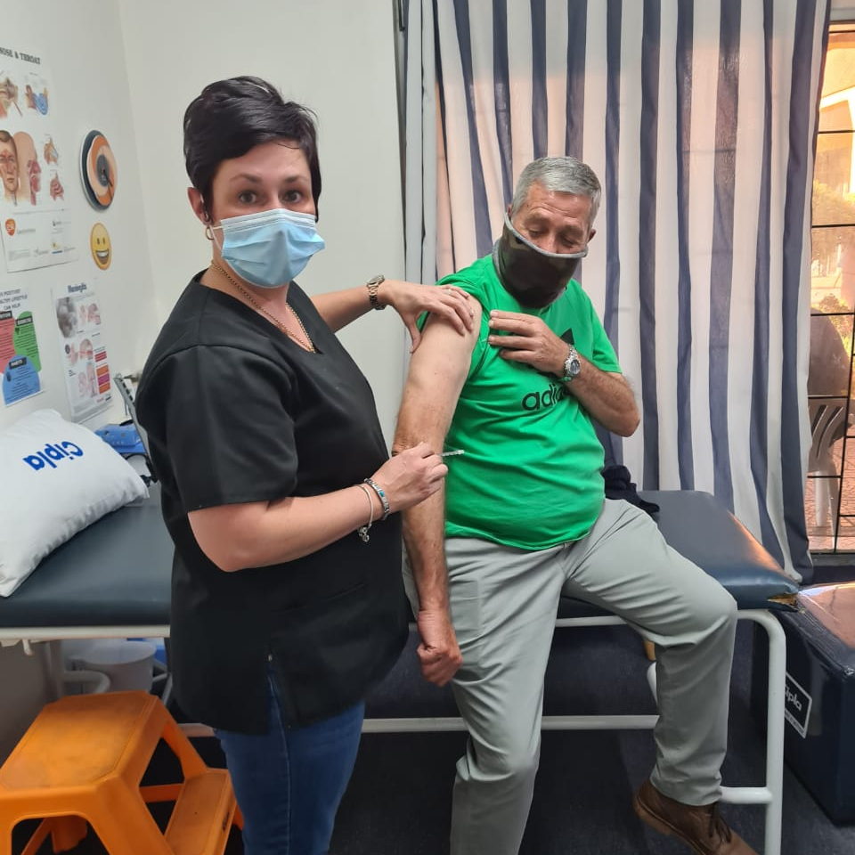
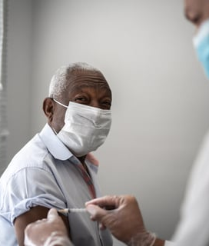
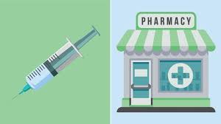
Vaccinations in Pharmacy Clinics

Slide 14
The Experience
The experience on the ground remains one of hope and positivity
Millions already vaccinated
35s and over registering and arriving with parents & grandparents to be vaccinated
18s and over already phoning to book for 01 September 2021
Large supply of vaccines secured for the foreseeable future
Negotiation of smaller pack size delivery of vaccines allowing more pharmacies and GPs to join
Every vaccination has the potential to save a life

