Slide 1
COVID EPI UPDATE
5 August 2021

Slide 2
7-day moving average number of new cases by province and date of reporting, 12 April 2020 to date, South Africa

Slide 3
Provincial updates

Slide 4

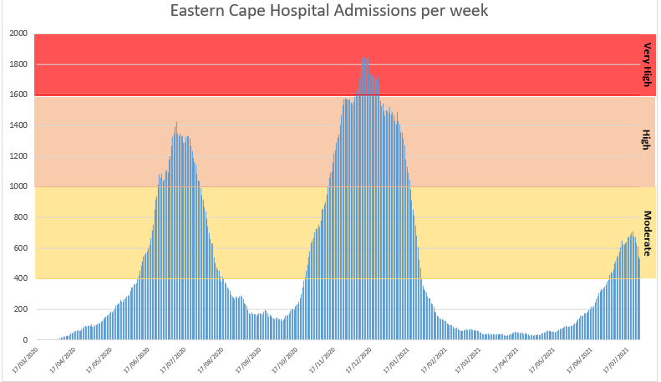
Eastern Cape:
Progress & Challenges
The increase in cases in EC are being driven by Nelson Mandela Bay Metro and Sarah Baartman
Hospital admissions in the province are currently in the moderate zone indicating slightly increased case fatality rates for hospitalized patients (zones as defined by the MAC)

Slide 5
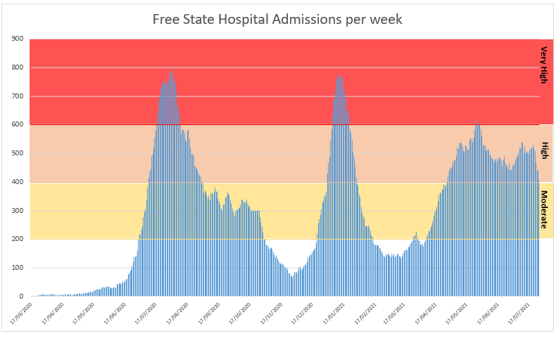
Free State:
Progress & Challenges
All districts in the FS are contributing to the high case loads observed in the province
Hospital admissions in the province are currently in the high zone indicating increased case fatality rates for hospitalized patients (zones as defined by the MAC) – admissions have remained in this zone since March, indicating continued strain on HCWs in the province

Slide 6
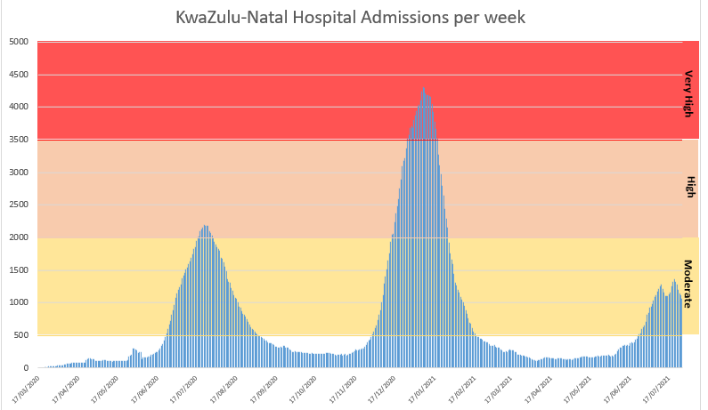
KwaZulu-Natal:
Progress & Challenges
Increase in new cases, nearing the pre-unrest levels. Increase in eThekwini and Zululand
Hospital admissions in the province are currently in the moderate zone
There are several clusters across the province contributing to the upsurge in number of cases.
Compliance to COVID-19 regulations is a challenge as there are few protests especially in eThekwini Metro Municipality.
Non-compliance of COVID-19 regulations during funeral services.
Notes:
The province was involved in the unrest mid-July, which disrupted the health care services hence the sharp decline in number of cases. If you look at the epidemiologic curve for KZN, the cases started to increase again immediately after unrest though it was a steady increase as some services were still being restored.
There are several clusters across the province contributing to the upsurge in number of cases.
Compliance to COVID-19 regulations is a challenge as there are few protests especially in eThekwini Metro Municipality.
Non-compliance of COVID-19 regulations during funeral services.

Slide 7
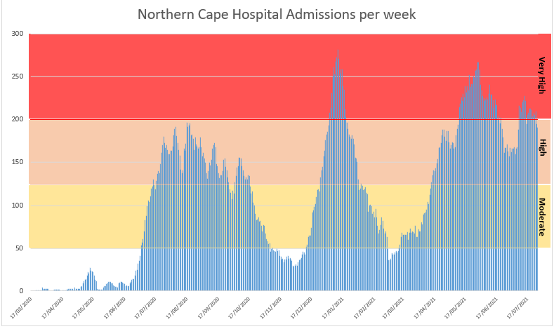
Northern Cape:
Progress & Challenges
Majority of the districts are showing increases in cases, the highest number of cases - ZF Mgcawu, Francis Baard and Pixley Ka Seme
Hospital admissions in the province are currently in the very high zone
Funerals that do not adhere to the regulations
Social events that do not adhere to the regulations
Notes:
• Funerals that do not adhere to the regulations
• Social events that do not adhere to the regulations
• Contact tracing process is compromised as contact tracers are being used as vaccinators
• There are teams on the ground educating community members about the impact of attending funerals and social events, but they can’t be everywhere
• Namakwa district is close to Western Cape and Namibia, increase of cases in these two areas influences number of cases in Namakwa.
• Francis Baard district- It is currently peaking since testing rate increased. Previous decline due to lack of capacity; teams that were responsible for testing/ contact tracing were assigned to vaccination but lately there are mobile labs that are going to communities to test.
• There are private labs with delayed TAT- compromises public health response which increases the risk of infection

Slide 8
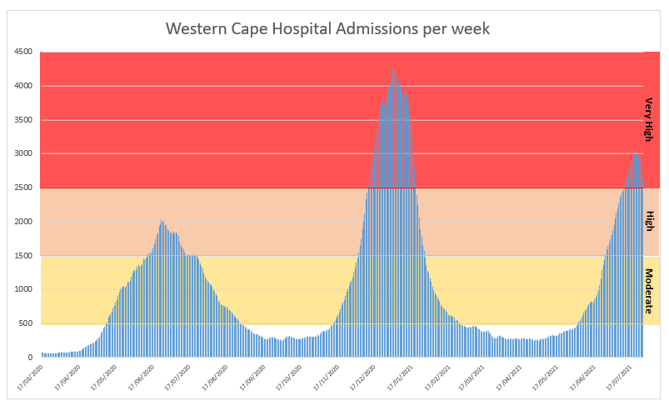
Western Cape:
Progress & Challenges
Majority of the districts are showing increases in cases, highest - Cape Town Metro.
Hospital admissions in the province are currently in the very high zone indicating high case fatality rates
Household, workplace and congregate residential cluster outbreaks contributing to increases
The recent taxi violence and resultant decrease in mobility
It is therefore difficult to say whether the province has reached the peak of the third wave

Slide 9
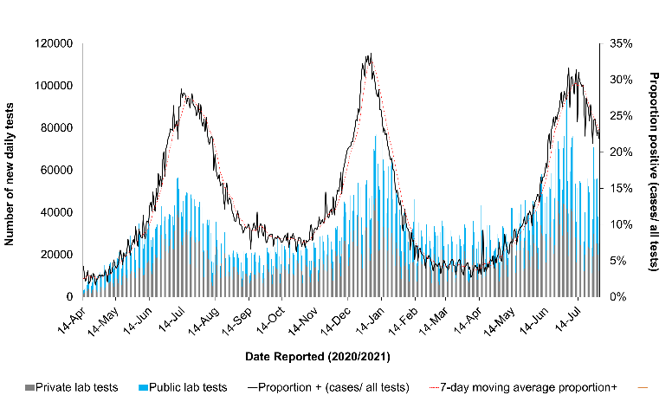
Testing – PCR and antigen
Week number | Week beginning | Percentage testing positive (%)
14 | 04-Apr-21 | 4.0
15 | 11-Apr-21 | 4.8
16 | 18-Apr-21 | 5.1
17 | 25-Apr-21 | 5.8
18 | 02-May-21 | 6.9
19 | 09-May-21 | 8.3
20 | 16-May-21 | 9.8
21 | 23-May-21 | 11.4
22 | 30-May-21 | 13.4
23 | 06-Jun-21 | 17.7
24 | 13-Jun-21 | 23.8
25 | 20-Jun-21 | 27.4
26 | 27-Jun-21 | 29.9
27 | 04-Jul-21 | 32.1
28 | 11-Jul-21 | 31.8
29 | 18-Jul-21 | 28.6
30 | 25-Jul-21 | 25.9
Sector | Total tested
PRIVATE | 8 305 131 | 56%
PUBLIC | 6 621 451 | 44%
Total | 14 926 582
The percentage testing positive in week 30 of 2021 was 25.9%, which was 2.7% lower than the previous week (28.6%)
Number of new daily tests for SARS-CoV-2 and proportion positive by date of reporting and health sector, and 7-day moving average proportion positive, 6 April 2020 to date, South Africa

Slide 10
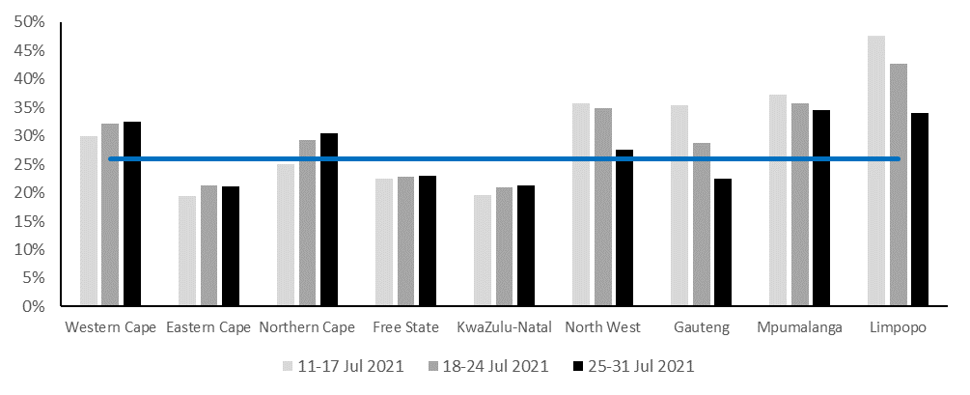
Weekly percentage testing positive
Percentage positive tests
Highest in Mpumalanga (34.5%), Limpopo (33.9%), Western Cape (32.5%), and Northern Cape (30.5%) provinces.
Decreased in the North West, Gauteng, Mpumalanga and Limpopo. The percentage testing positive remained unchanged in the Western Cape, Eastern Cape, Northern Cape, Free State and KwaZulu-Natal.

Slide 11
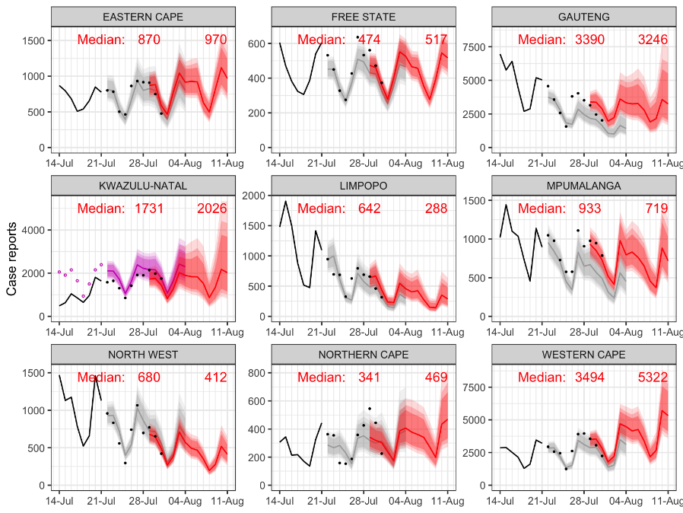
Daily new cases forecast
Red text indicates median at the beginning and end of the most recent forecast period
Notes:
Max shown middle 70%; darkest is middle 50%

Slide 12
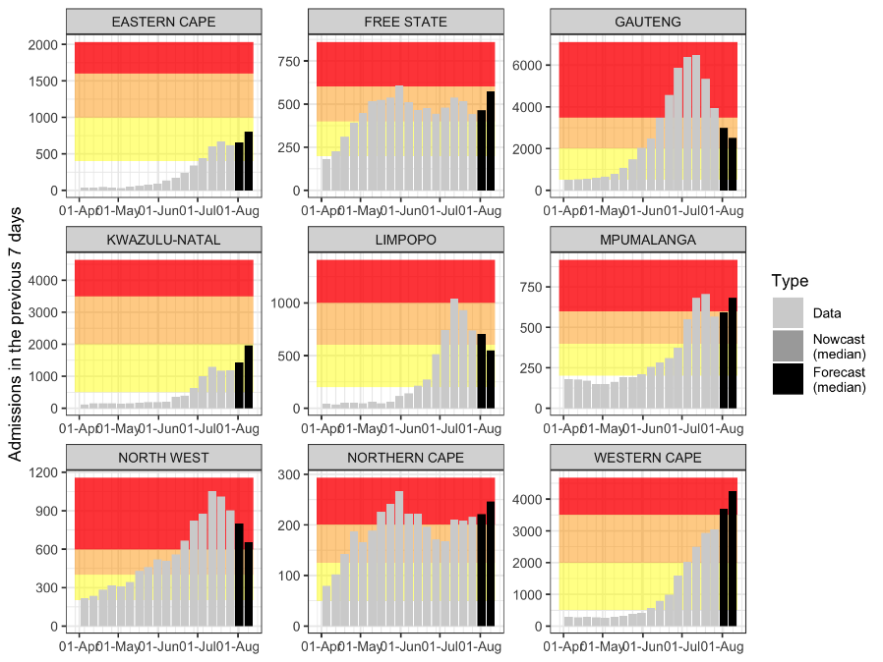
Weekly hospital admissions forecast
Red band indicates very high admissions load
Orange band indicates high admissions load
Yellow band indicates medium admissions load

Slide 13
Previous 14 days and current 14 days average COVID-19 admissions and deaths and percentage changes, South Africa, 26 June-24 July 2021
Province | Hospital admissions |  | Percentage change in admissions | Hospital deaths |  | Percentage change in deaths
 | Previous 14 days admissions average | Current 14 days admissions average |  | Previous 14 days deaths average | Current 14 days deaths average
Eastern Cape | 89.21 | 81.86 | -8.25 | 22.21 | 24.71 | 11.25
Free State | 74.64 | 59.50 | -20.29 | 18.21 | 15.86 | -12.94
Gauteng | 863.64 | 466.00 | -46.04 | 229.86 | 163.07 | -29.06
KwaZulu-Natal | 173.93 | 165.43 | -4.89 | 34.64 | 40.93 | 18.14
Limpopo | 140.57 | 91.14 | -35.16 | 38.43 | 33.57 | -12.64
Mpumalanga | 99.86 | 72.43 | -27.47 | 24.36 | 22.57 | -7.33
North West | 145.57 | 109.36 | -24.88 | 29.57 | 26.86 | -9.18
Northern Cape | 30.07 | 25.71 | -14.49 | 6.93 | 8.36 | 20.62
Western Cape | 383.71 | 434.14 | 13.14 | 69.57 | 94.50 | 35.83

