Slide 1
Super Spreading Events and Solutions

Slide 2
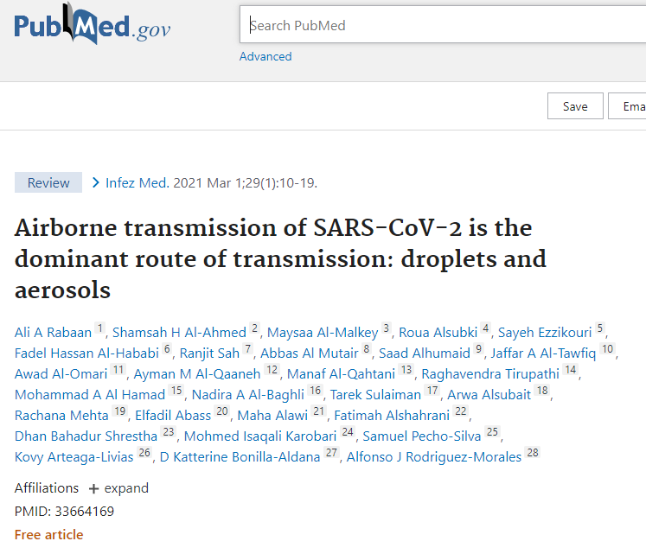
“The main transmission route of SARS-CoV-2 is through the air (airborne transmission).”

Slide 3
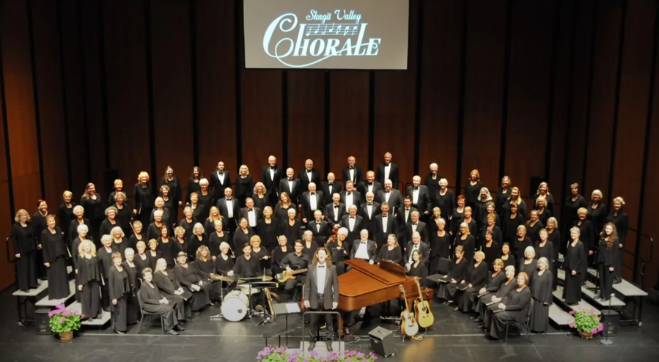
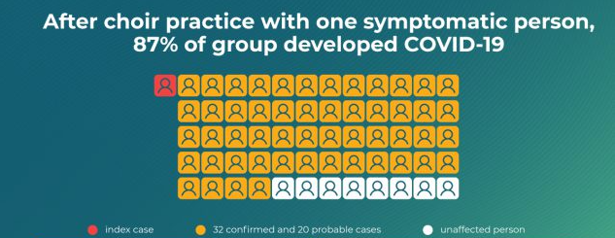

Slide 5
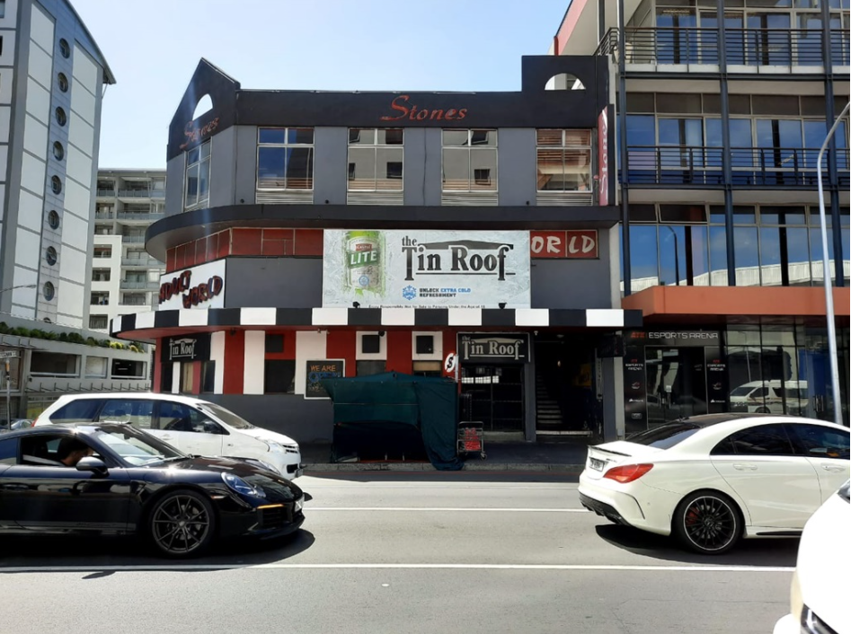
89 people infected in one night
HOW?
www.greenflagassociation.com
info@greenflagassociation.com

Slide 6
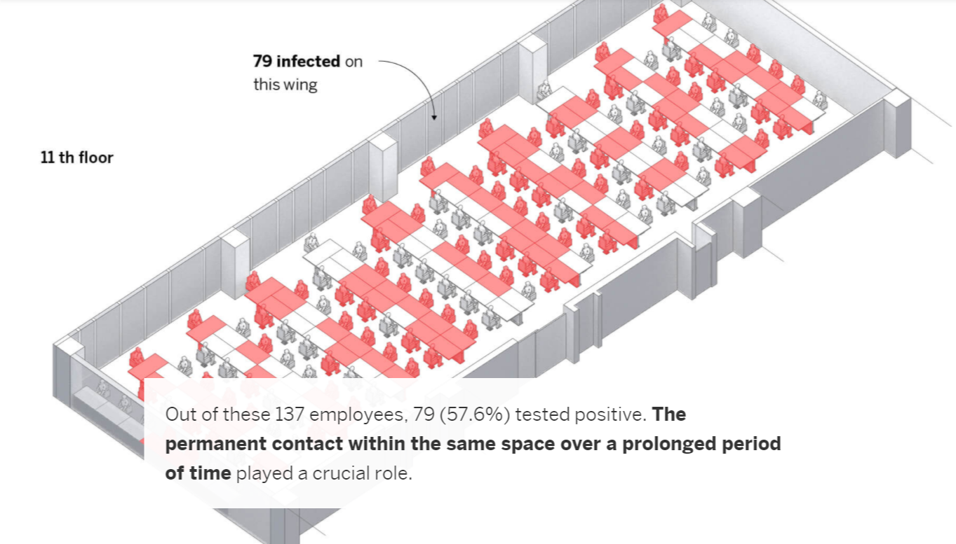
S Korea – call centre
www.greenflagassociation.com
info@greenflagassociation.com

Slide 7
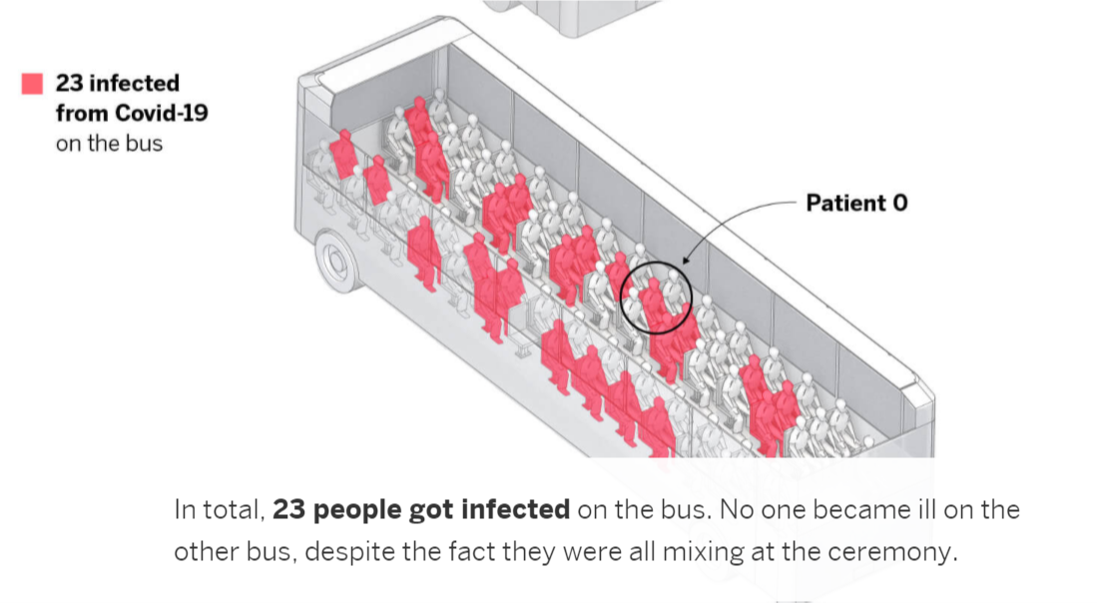
Chinese – Buddhist bus
www.greenflagassociation.com
info@greenflagassociation.com

Slide 8
In an open letter published July 6 2020, 239 scientists from 32 countries urge the World Health Organization and other bodies to address the potential for airborne transmission of the coronavirus.
The authors write that a growing body of evidence suggests “beyond any reasonable doubt” that the virus spreads indoors through tiny aerosols—a finding that should be reflected in the WHO’s recommendations.
www.greenflagassociation.com
info@greenflagassociation.com

Slide 9
April / May 2021: WHO & CDC finally Accept that SARS-Cov-2 is airborne
www.greenflagassociation.com
info@greenflagassociation.com

Slide 10
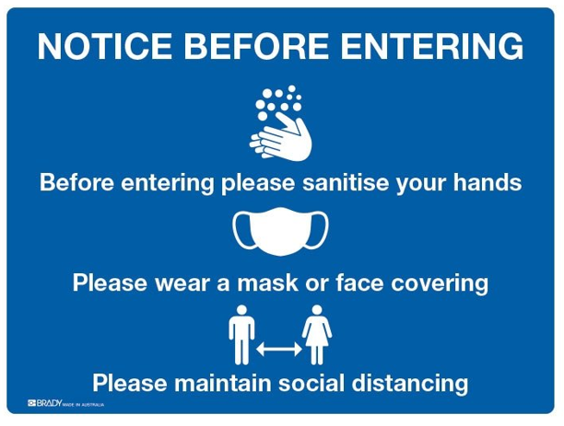
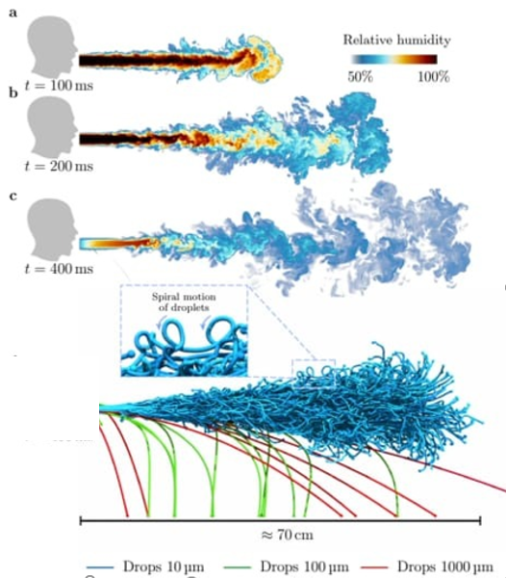
20 July 2021: Despite overwhelming evidence, messaging remains the key failure of government, associations, banks and corporates
www.greenflagassociation.com
info@greenflagassociation.com

Slide 11
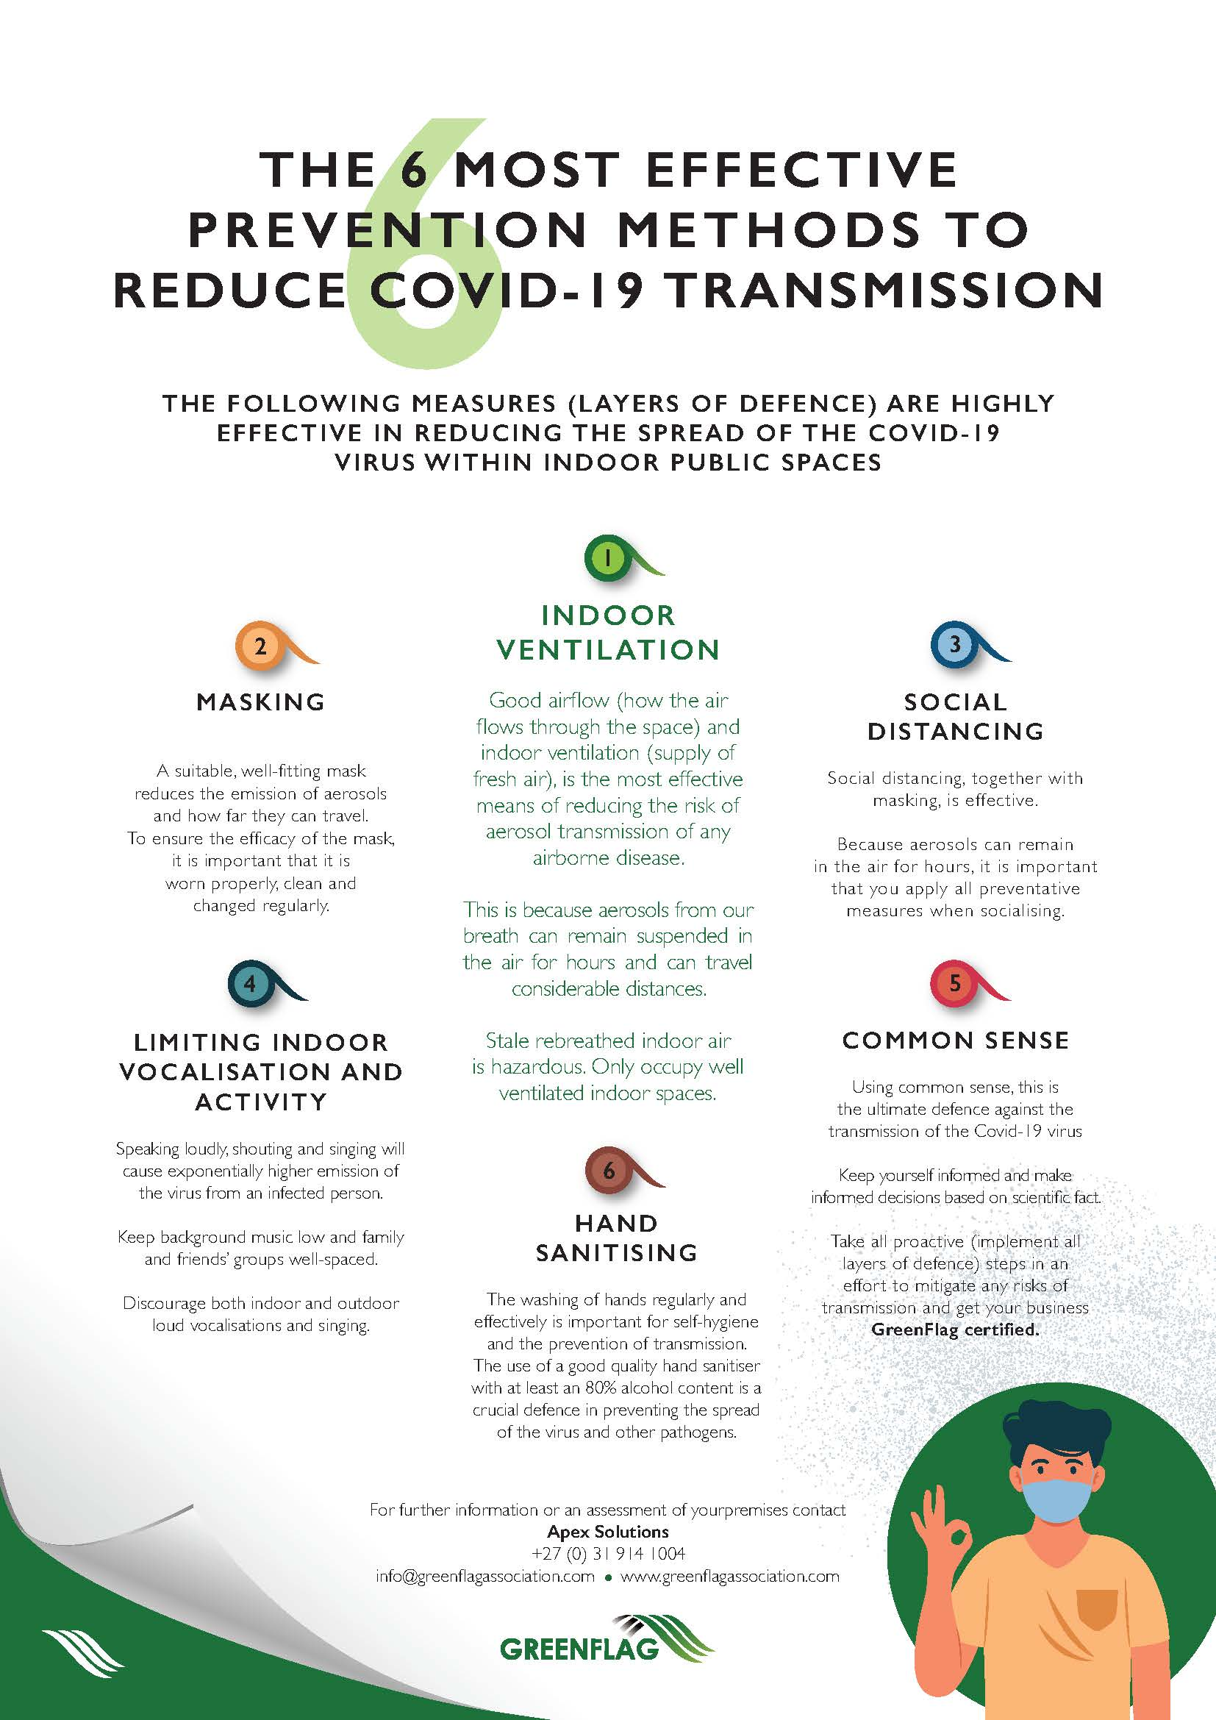
Challenge # 1:
Resolve your areas of DIRECT Influence
Get the messaging right!
Know your ventilations rates
Join the GreenFlag Association (Collaboration + Certification)
www.greenflagassociation.com
info@greenflagassociation.com

Slide 12
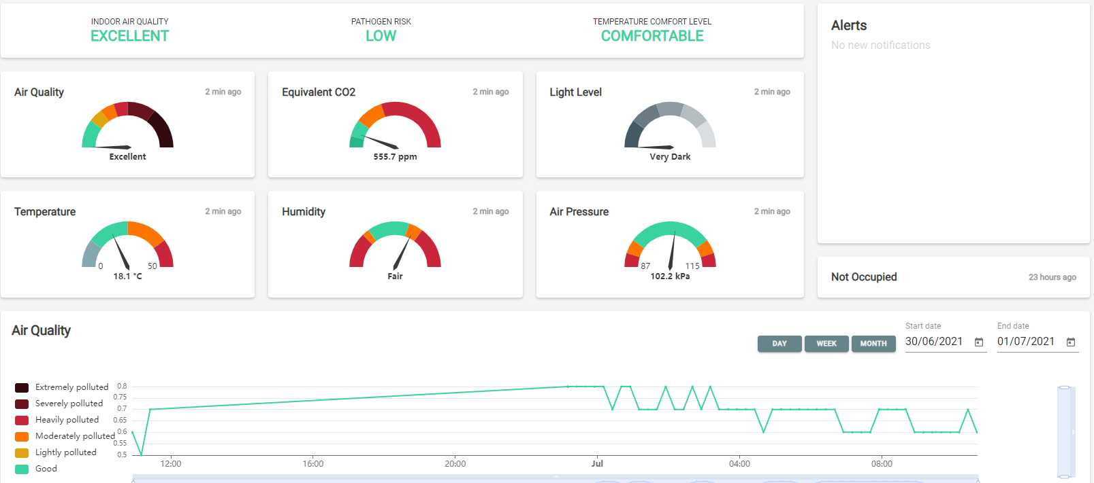
The GreenFlag Association Continuous Monitoring Platform
Continuous Monitoring allows for dynamic real-time risk management of occupied spaces

Slide 13
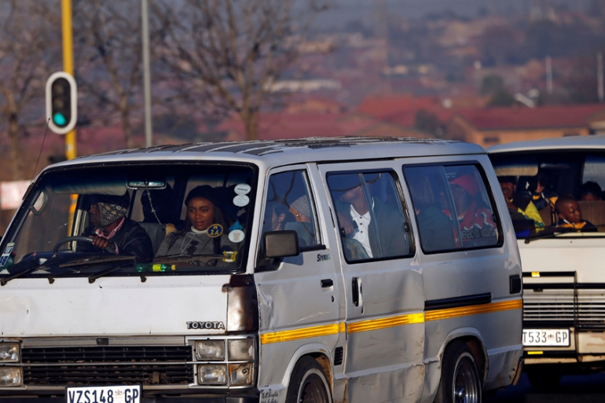
Challenge # 2:
Make a commitment to influence policy at the highest level
President Ramaphosa to intervene?
Metro police involvement?
Media Solidarity initiative- all the media push the revised messaging until after lockdown 4
Three infected South Africans climb into a packed (unventilated) taxi….travel for 30 minutes – how many infected people get out?
Viral shedding can be at its highest 1-2 days prior to symptoms

Slide 14
“The only thing necessary for the triumph of evil is for good men to do nothing.” Edmund Burke

