Slide 1
COVID-19
Taking Stock on vaccine supply and distribution for set milestones
30 July 2021

Slide 2
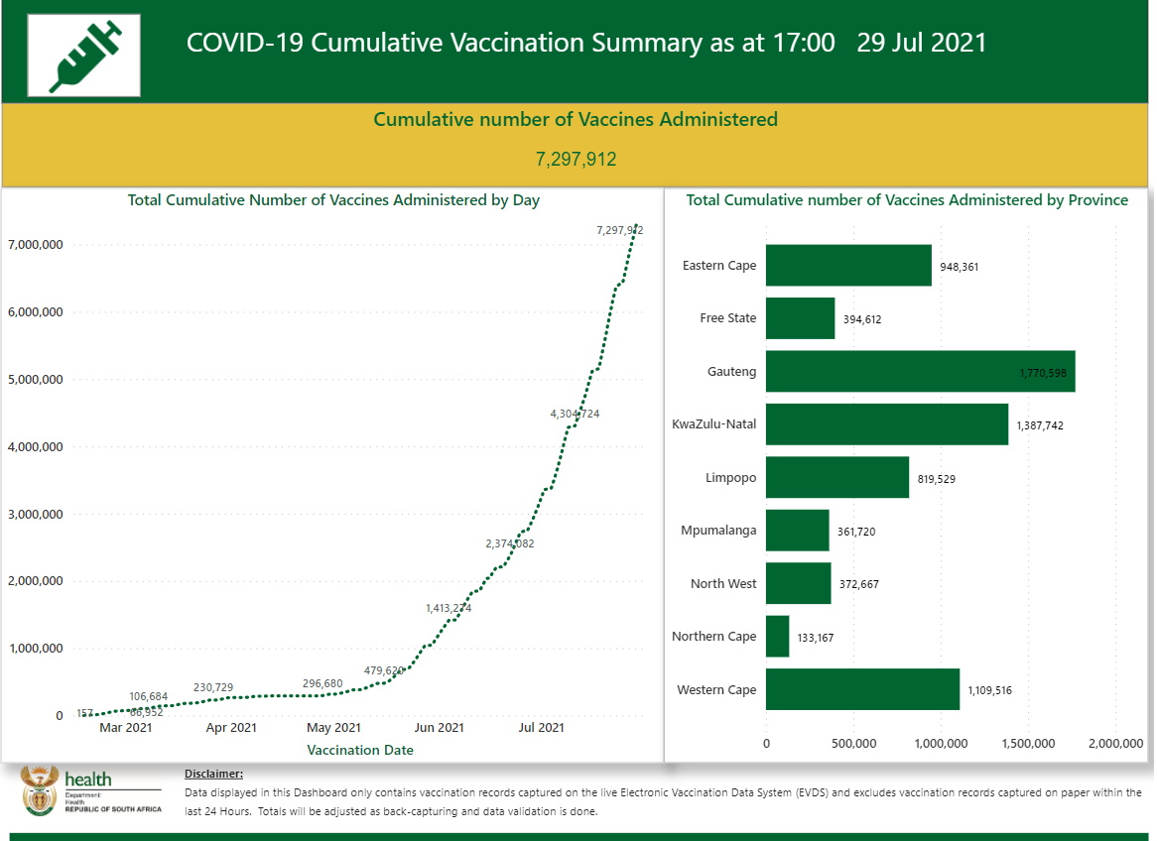
How far are we on our vaccination journey?
7 297 912

Slide 3
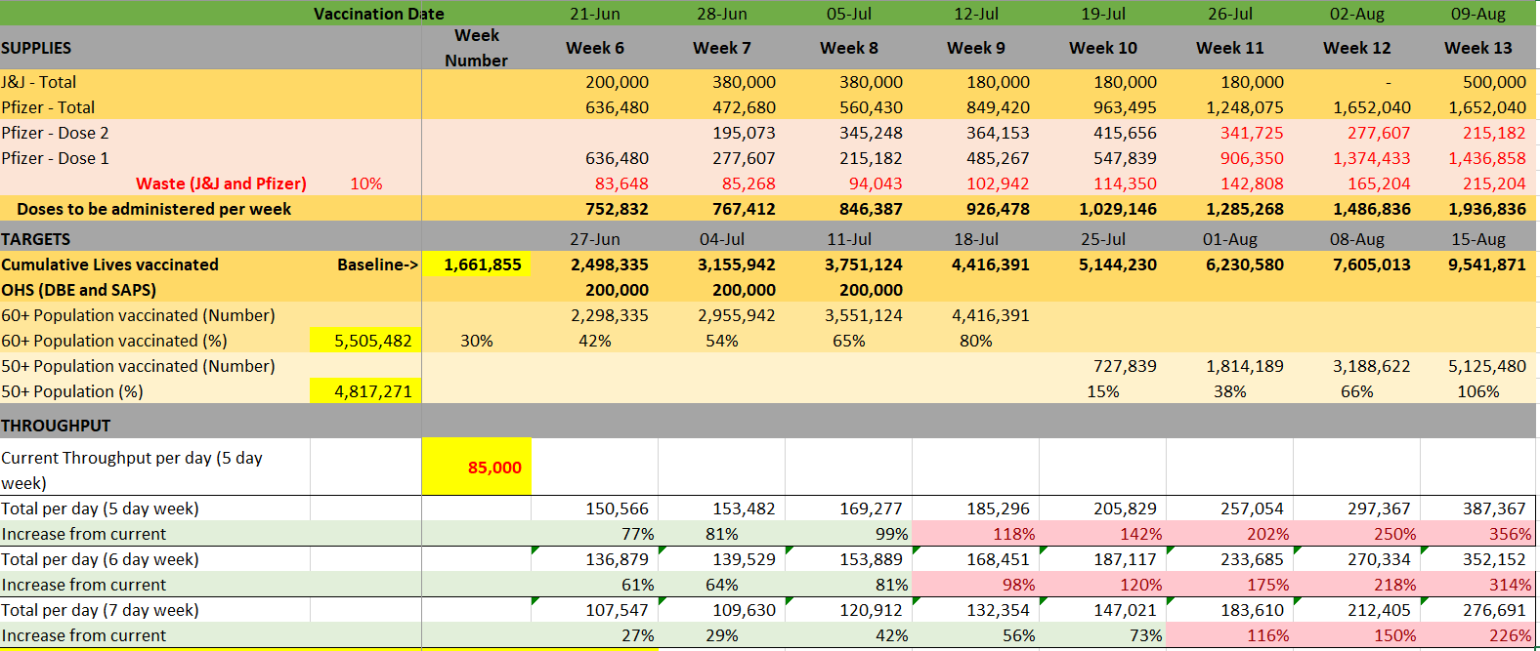


What were our targets during the past month?
Overall vaccination
target achieved
However, most
vulnerable not reached sufficiently
Throughput vaccination targets achieved.
Desired public/private mix not reached

Slide 4

Let us not leave the most at risk and vulnerable behind
Target for August: 7 million aged 35+, of which 1 million aged 60+
Additionally Prioritise:
Uninsured
Males
At least 1 of 7 vaccinations
should be for 60+ during August
10 districts will need to target
1 in every 3 vaccinations for 60+

Slide 5
Daily Vaccination Targets for each Province
Throughput targets by Province
Increase in through put from baseline

Slide 6
Vaccination Cumulative Dashboard
Vaccine supply security
National vaccine pipeline
  Pfizer Sources
    Pfizer direct procurement
    Covax procurement
    Covax donation from the US
  J&J
    From Johnson and Johnson (Jansen)
    Provinces using J&J (short expiry) for the general population from Monday 26th July
      emphasis on districts with low coverage and hard to reach groups
      remaining stock has been distributed to provinces
      Channelling to SASSA pension paypoints
Notes:
textbox
No alt text provided.
image
No alt text provided.
image
No alt text provided.
textbox
No alt text provided.
shape
No alt text provided.
Total Individuals Vaccinated 1st Dose (7 Day Averages)
No alt text provided.
Total Individuals Vaccinated 1st Dose (7 Day Averages)
No alt text provided.
Cumulative number of Vaccinations Administered
No alt text provided.
Total Cumulative number of Vaccinations Administered by Province
No alt text provided.
Total Cumulative Number of Vaccinations Administered by Day
No alt text provided.
card
No alt text provided.
card
No alt text provided.

Slide 7
Quarterly and Weekly Supply (Supply visibility)
Quarterly
30 July 2021
7 days stock on hand, based on daily vaccinations of 250,000
1 556 100 Pfizer doses arriving Sunday 1 August for distribution next week
5 660 460 Pfizer doses arriving between 31 July and 3 August. NCL release may take up to 1 week
1 454 900 J&J doses expected to be distributed in the week of 2 August
Weekly (immediate horizon)

Slide 8
Conclusion
Provided the vaccines are delivered on schedule there is no vaccine constraint
At the anticipated rate of vaccination there are enough doses to complete the year and no more procurement is required

