Slide 1
Disclaimer
Notes:
textbox
No alt text provided.
textbox
No alt text provided.
slicer
No alt text provided.
image
No alt text provided.
image
No alt text provided.
image
No alt text provided.
image
No alt text provided.
card
No alt text provided.
textbox
No alt text provided.
textbox
No alt text provided.

Slide 2
Vaccine Sites Using EVDS
Notes:
slicer
No alt text provided.
textbox
No alt text provided.
textbox
No alt text provided.
slicer
No alt text provided.
Vaccine Sites Using EVDS Per Vaccination Week
No alt text provided.
Vaccine Sites Using EVDS Per Day
No alt text provided.
map
No alt text provided.
Vaccine Sites Using EVDS
No alt text provided.
card
No alt text provided.
slicer
No alt text provided.
textbox
No alt text provided.
image
No alt text provided.
image
No alt text provided.
image
No alt text provided.
slicer
No alt text provided.
image
No alt text provided.
slicer
No alt text provided.
slicer
No alt text provided.
slicer
No alt text provided.

Slide 3
Vaccines Administered 1/5
Notes:
Date
No alt text provided.
slicer
No alt text provided.
slicer
No alt text provided.
slicer
No alt text provided.
slicer
No alt text provided.
slicer
No alt text provided.
slicer
No alt text provided.
slicer
No alt text provided.
slicer
No alt text provided.
slicer
No alt text provided.
textbox
No alt text provided.
textbox
No alt text provided.
card
No alt text provided.
card
No alt text provided.
card
No alt text provided.
card
No alt text provided.
card
No alt text provided.
Number of Pfizer Vaccines Administered
No alt text provided.
Sisonke-Number of J&J Vaccines Administered
No alt text provided.
National-Number of J&J Vaccines Administered
No alt text provided.
card
No alt text provided.
card
No alt text provided.
card
No alt text provided.
textbox
No alt text provided.
slicer
No alt text provided.
image
No alt text provided.
image
No alt text provided.
image
No alt text provided.
image
No alt text provided.

Slide 4
Vaccines Administered 2/5
Notes:
Date
No alt text provided.
slicer
No alt text provided.
slicer
No alt text provided.
slicer
No alt text provided.
slicer
No alt text provided.
slicer
No alt text provided.
slicer
No alt text provided.
slicer
No alt text provided.
slicer
No alt text provided.
slicer
No alt text provided.
textbox
No alt text provided.
textbox
No alt text provided.
card
No alt text provided.
card
No alt text provided.
card
No alt text provided.
card
No alt text provided.
pivotTable
No alt text provided.
Vaccines Administered
No alt text provided.
textbox
No alt text provided.
textbox
No alt text provided.
textbox
No alt text provided.
textbox
No alt text provided.
textbox
No alt text provided.
slicer
No alt text provided.
image
No alt text provided.
image
No alt text provided.
image
No alt text provided.
image
No alt text provided.

Slide 5
Vaccines Administered 3/5
Notes:
Date
No alt text provided.
slicer
No alt text provided.
slicer
No alt text provided.
slicer
No alt text provided.
slicer
No alt text provided.
slicer
No alt text provided.
slicer
No alt text provided.
slicer
No alt text provided.
slicer
No alt text provided.
slicer
No alt text provided.
textbox
No alt text provided.
textbox
No alt text provided.
Cumulative Number of Vaccines Administered
No alt text provided.
card
No alt text provided.
textbox
No alt text provided.
slicer
No alt text provided.
image
No alt text provided.
image
No alt text provided.
image
No alt text provided.
image
No alt text provided.
Number of Vaccines Administered Per Day
No alt text provided.

Slide 6
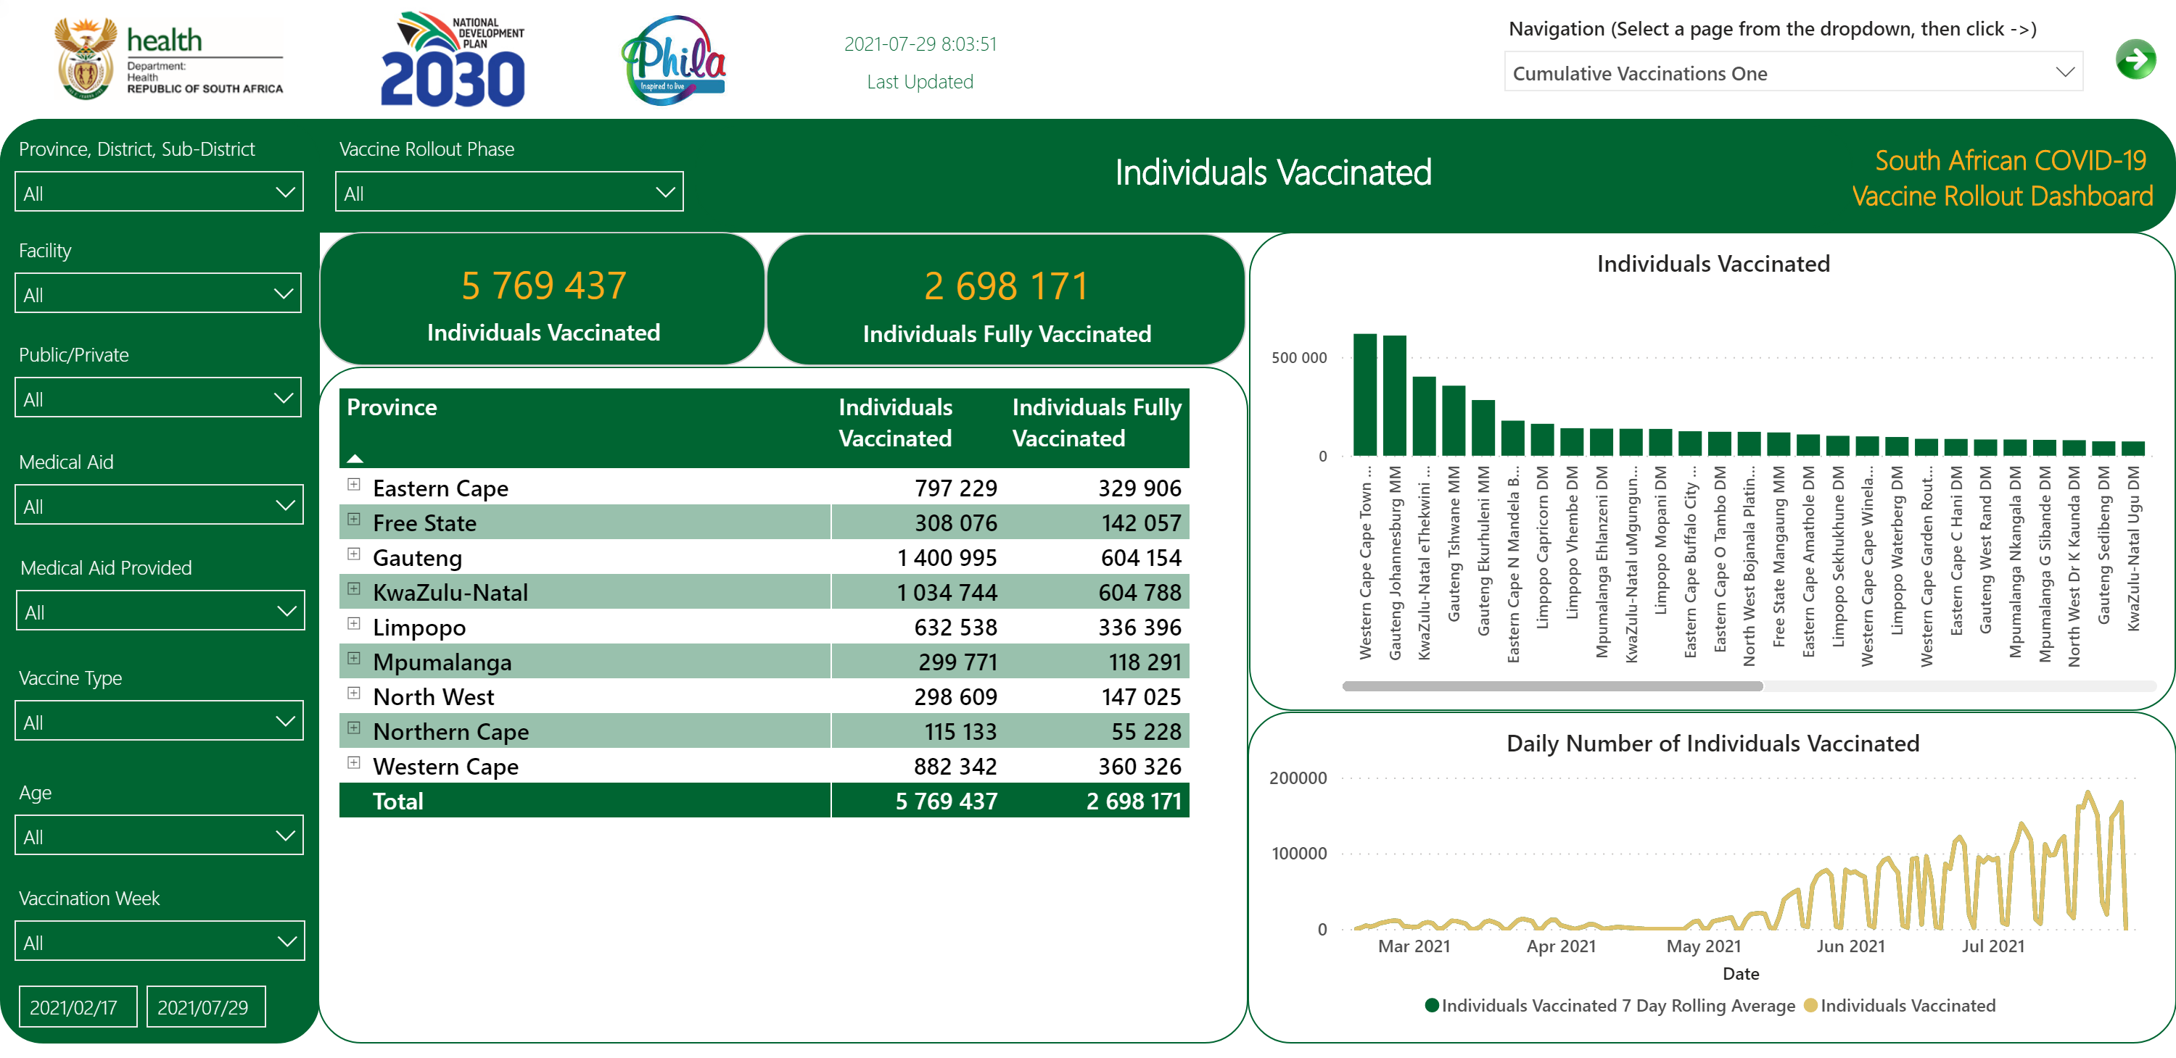
Individuals Vaccinated 1/6
Notes:
slicer
No alt text provided.
textbox
No alt text provided.
textbox
No alt text provided.
card
No alt text provided.
slicer
No alt text provided.
slicer
No alt text provided.
card
No alt text provided.
textbox
No alt text provided.
slicer
No alt text provided.
slicer
No alt text provided.
slicer
No alt text provided.
slicer
No alt text provided.
slicer
No alt text provided.
slicer
No alt text provided.
slicer
No alt text provided.
image
No alt text provided.
image
No alt text provided.
image
No alt text provided.
image
No alt text provided.
Date
No alt text provided.
card
No alt text provided.
Individuals Vaccinated
No alt text provided.
pivotTable
No alt text provided.
Daily Number of Individuals Vaccinated
No alt text provided.

Slide 7
Individuals Vaccinated 3/6
Notes:
Date
No alt text provided.
slicer
No alt text provided.
slicer
No alt text provided.
slicer
No alt text provided.
slicer
No alt text provided.
slicer
No alt text provided.
slicer
No alt text provided.
slicer
No alt text provided.
slicer
No alt text provided.
slicer
No alt text provided.
textbox
No alt text provided.
textbox
No alt text provided.
card
No alt text provided.
textbox
No alt text provided.
basicShape
No alt text provided.
slicer
No alt text provided.
image
No alt text provided.
image
No alt text provided.
image
No alt text provided.
image
No alt text provided.
card
No alt text provided.
card
No alt text provided.
Individuals Vaccinated by Age and Sex
No alt text provided.
pivotTable
No alt text provided.
Individuals Vaccinated by Age and Sex To Date
No alt text provided.

Slide 8
Individuals Vaccinated 4/6
Notes:
Date
No alt text provided.
slicer
No alt text provided.
slicer
No alt text provided.
slicer
No alt text provided.
slicer
No alt text provided.
slicer
No alt text provided.
slicer
No alt text provided.
slicer
No alt text provided.
slicer
No alt text provided.
slicer
No alt text provided.
textbox
No alt text provided.
textbox
No alt text provided.
card
No alt text provided.
card
No alt text provided.
card
No alt text provided.
pivotTable
No alt text provided.
Individuals Vaccinated by Age and Sex
No alt text provided.
Individuals Vaccinated by Age and Sex To Date
No alt text provided.
basicShape
No alt text provided.
textbox
No alt text provided.
slicer
No alt text provided.
image
No alt text provided.
image
No alt text provided.
image
No alt text provided.
image
No alt text provided.

Slide 9
Individuals Vaccinated 5/6
Notes:
textbox
No alt text provided.
textbox
No alt text provided.
slicer
No alt text provided.
pivotTable
No alt text provided.
slicer
No alt text provided.
slicer
No alt text provided.
National
No alt text provided.
card
No alt text provided.
textbox
No alt text provided.
textbox
No alt text provided.
slicer
No alt text provided.
slicer
No alt text provided.
image
No alt text provided.
image
No alt text provided.
image
No alt text provided.
image
No alt text provided.

Slide 10
Individuals Vaccinated 6/6
Notes:
textbox
No alt text provided.
textbox
No alt text provided.
slicer
No alt text provided.
slicer
No alt text provided.
COVID-19 Vaccinations Daily Totals
No alt text provided.
card
No alt text provided.
textbox
No alt text provided.
slicer
No alt text provided.
image
No alt text provided.
image
No alt text provided.
image
No alt text provided.
image
No alt text provided.

Slide 11
Public Healthcare Workers
Notes:
slicer
No alt text provided.
textbox
No alt text provided.
textbox
No alt text provided.
slicer
No alt text provided.
slicer
No alt text provided.
slicer
No alt text provided.
slicer
No alt text provided.
slicer
No alt text provided.
slicer
No alt text provided.
slicer
No alt text provided.
slicer
No alt text provided.
slicer
No alt text provided.
slicer
No alt text provided.
slicer
No alt text provided.
card
No alt text provided.
textbox
No alt text provided.
slicer
No alt text provided.
image
No alt text provided.
image
No alt text provided.
image
No alt text provided.
image
No alt text provided.
textbox
No alt text provided.
Numbers of Vaccinated Public Health Care Workers (HCW) out of Total Registered Public HCW
No alt text provided.

Slide 12
Education Sector
Notes:
slicer
No alt text provided.
textbox
No alt text provided.
slicer
No alt text provided.
slicer
No alt text provided.
textbox
No alt text provided.
slicer
No alt text provided.
slicer
No alt text provided.
slicer
No alt text provided.
slicer
No alt text provided.
slicer
No alt text provided.
slicer
No alt text provided.
slicer
No alt text provided.
slicer
No alt text provided.
card
No alt text provided.
textbox
No alt text provided.
Numbers of Vaccinated Individuals in Education Sector out of Total Registered Individuals Registered in Education Sector
No alt text provided.
textbox
No alt text provided.
slicer
No alt text provided.
image
No alt text provided.
image
No alt text provided.
image
No alt text provided.
image
No alt text provided.

Slide 13
SANDF
Notes:
slicer
No alt text provided.
textbox
No alt text provided.
textbox
No alt text provided.
slicer
No alt text provided.
slicer
No alt text provided.
slicer
No alt text provided.
slicer
No alt text provided.
slicer
No alt text provided.
slicer
No alt text provided.
slicer
No alt text provided.
slicer
No alt text provided.
slicer
No alt text provided.
card
No alt text provided.
textbox
No alt text provided.
Numbers of Vaccinated Individuals in the South African National Defence Force (SANDF) out of Total Registered Individuals Registered in SANDF
No alt text provided.
slicer
No alt text provided.
image
No alt text provided.
image
No alt text provided.
image
No alt text provided.
image
No alt text provided.

Slide 14
SAPS
Notes:
slicer
No alt text provided.
textbox
No alt text provided.
textbox
No alt text provided.
slicer
No alt text provided.
slicer
No alt text provided.
slicer
No alt text provided.
slicer
No alt text provided.
slicer
No alt text provided.
slicer
No alt text provided.
slicer
No alt text provided.
slicer
No alt text provided.
slicer
No alt text provided.
card
No alt text provided.
textbox
No alt text provided.
Numbers of Vaccinated Individuals in the South African Police Service (SAPS) out of Total Registered Individuals Registered in SAPS
No alt text provided.
slicer
No alt text provided.
image
No alt text provided.
image
No alt text provided.
image
No alt text provided.
image
No alt text provided.

